Slide 1

Exploring the Cigarette Data Set
Lesson 10 Final Project
Amrita Guha

Slide 2
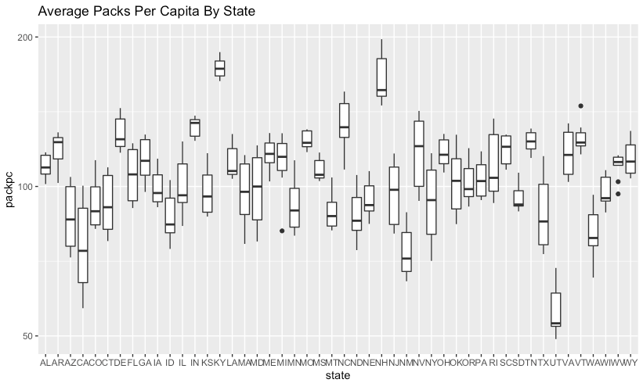
Average Number of Packs Per Capita By State
Kentucky, New Hampshire, and North Carolina have the highest number of packs per capita. Utah and California have the lowest number of packs per capita.

Slide 3
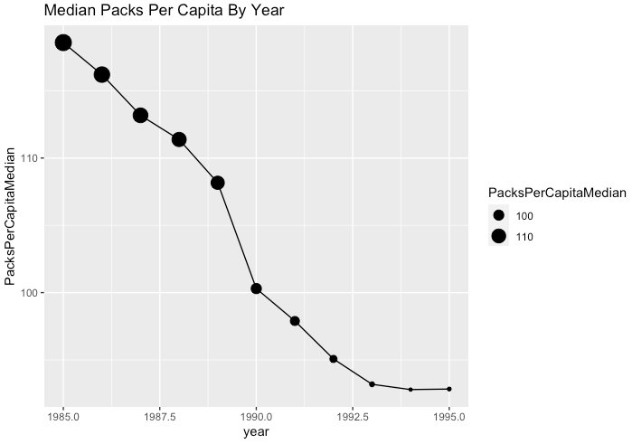
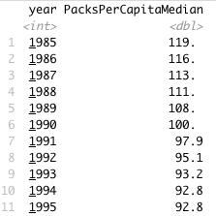
Median Packs Per Capita By Year
Cigarette usage was on a decline from 1985 through 1995. By 1995, there was approximately a 22% decline from 1985 in the median number of packs per capita for each year over all states.
This trend may be attributed to people learning more about the dangers of smoking.

Slide 4
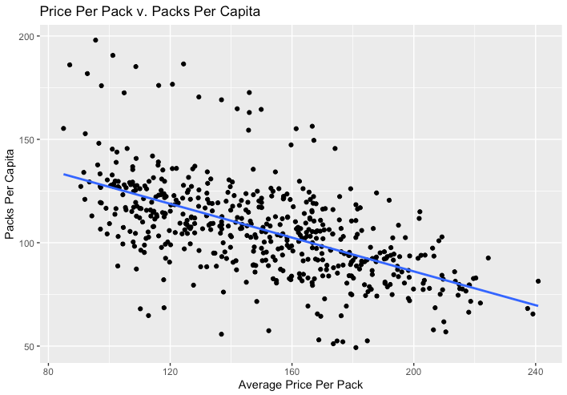
Scatter Plot:
Price Per Pack vs Number of Packs Per Capita
The price per pack and packs per capita variables (over all states and all years) are negatively correlated.
This correlation is to be expected because as the price for a good or product increases, the less people are inclined to buy it.

Slide 5
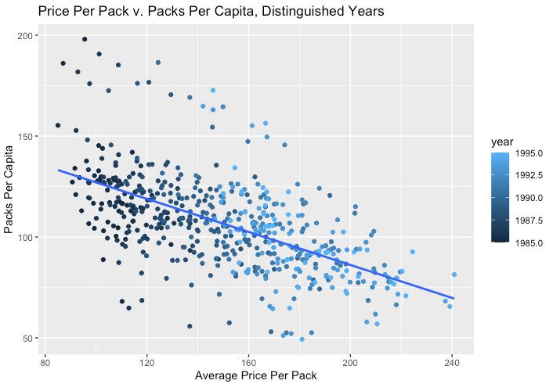

Scatter Plot:
Price Per Pack vs Number of Packs Per Capita (Years Distinguished)
The data reflects that the relationship between the price per pack and the packs per capita does change over time.
It seems that as time went on, the price per pack increased, and packs per capita decreased.

Slide 6
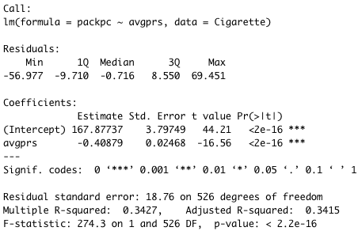
Linear Regression:
Price Per Pack vs Number of Packs Per Capita
The line explains 34.15% of the variability in the data.
However, since the p value is far less than 0.05, the model is not statistically significant.

Slide 7
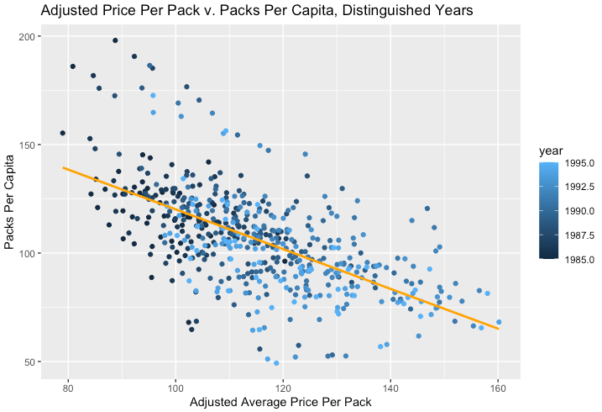
Scatter Plot:
Price Per Pack vs Number of Packs Per Capita, Adjusted for Inflation
When adjusted for inflation, the only difference in the data is that the average price per pack is lower for every state in every year. This makes the best fit line steeper than it was in the previous graph.

Slide 8
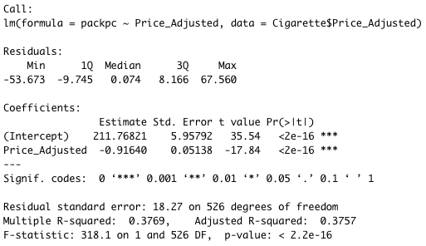

Linear Regression:
Price Per Pack vs Number of Packs Per Capita, Adjusted for Inflation
When adjusted for inflation, the line explains 37.57% of the variability in the data.
However, since the p value is far less than 0.05, the model is not statistically significant.

Slide 9
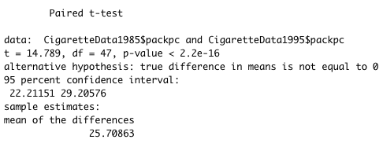


Paired t-test:
Comparing Packs Per Capita in 1995 vs. Packs Per Capita in 1985
The number of packs per capita in 1995 was significantly different than the number of packs per capita in 1985.
The t-test reflects that the true difference between the means is somewhere between 22.21 and 29.21

Slide 10
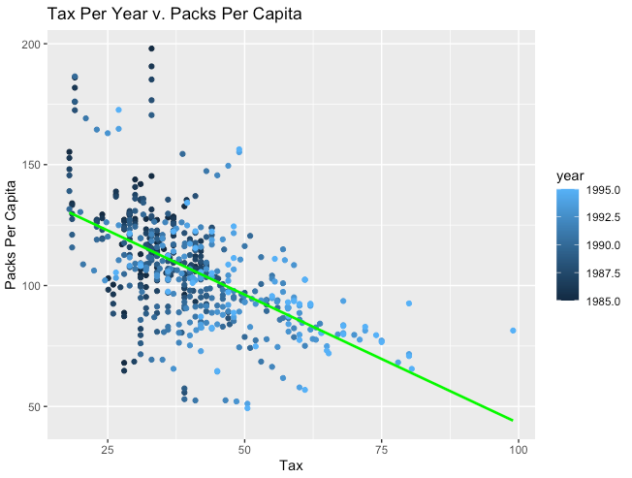
Additional Question:
Does the Tax Rate Affect the Number of Packs Per Capita?
The data reflects a negatively correlated relationship between the tax per year and the packs per capita does change over time.
It seems that as time went on, the tax increased, and packs per capita decreased.
However, since correlation does not equal causation, we can do a linear regression to determine whether the tax rate in a year explains changes in the number of packs per capita.

Slide 11
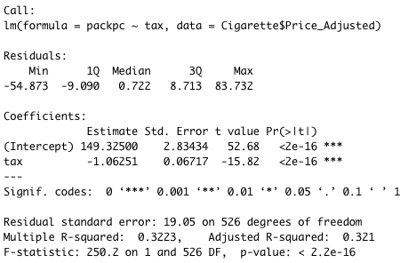

Additional Question (continued):
Does the Tax Rate Affect the Number of Packs Per Capita?
Under a linear regression to determine whether the tax rate in a year explains changes in the number of packs per capita, the line explains 32.1% of the variability in the data.
However, since the p value is far less than 0.05, the model is not statistically significant.

